Slide 1

COMP 5350 / 6350 / 6356 Digital Forensics Spring 2019

Slide 2
Agenda
Instructor Introduction
Administration
Course Introduction
History
Digital Forensics Research Conference
Legal Standards for Digital Forensics
Digital Evidence Collection and Archiving
Incident Response
Forensics Testing Environment

Slide 3

Instructor Introduction
Jason Cuneo
West Point, 1998, B.S. Electrical Engineering
U.S. Army, Infantry Officer, 1998 – 2004
UAH, 2006, M.S. Electrical Engineering
Auburn, Current, PhD Program, C.S. & Software Engineering
Experience
Defensive Cyber Operations
Cyber Training
Advanced Networking
Cyber Exercises
Vulnerability Assessment
Microelectronics
Hardware Analysis
Blockchain
Cryptocurrencies

Slide 4
Administration
Course Dates:
10 January – 25 April 2019
Thursday, 5:00 – 7:30 pm
Facilities
Shelby 1103
Emergency Exits
Restrooms
Breaks
Digital Forensics Lab

Slide 5
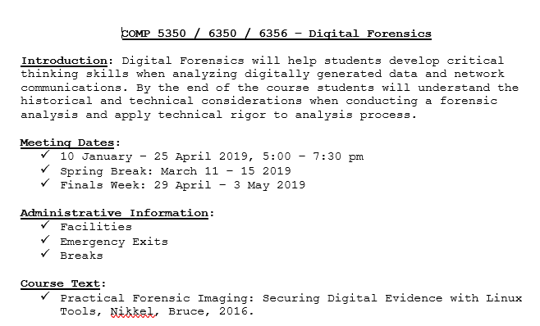
Course Syllabus

Slide 6
Course Description and Learning Objectives
Description: Computer compromise and forensics, with focus on computer crime and ways to uncover, protect, and exploit digital evidence
The learning objectives for the Digital Forensics course include:
Understand how digital forensics can be used to collect and analyze digital artifacts
Select digital forensic collection and analysis tools
Understand differences in operating systems and associated file systems
Apply sound digital forensics analysis techniques to identify system and network intrusions

Slide 7
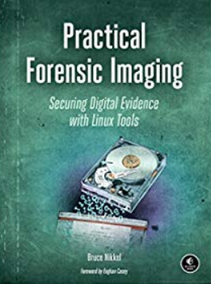
Course Text
Practical Forensic Imaging: Securing Digital Evidence with Linux Tools, Bruce Nikkel, 2016

Slide 8
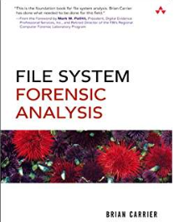
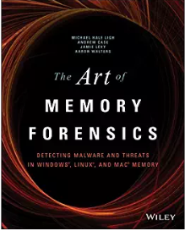
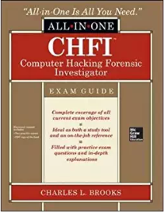

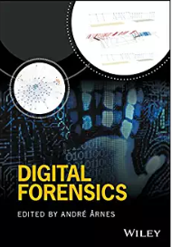
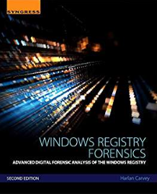
Additional References
Digital Forensics, 2017
Windows Registry Forensics, 2016
Computer Hacking Forensics Investigator, 2015
The Art of Memory Forensics, 2014
Digital Forensics with Open Source Tools, 2011
File System Forensics Analysis, 2005

Slide 9
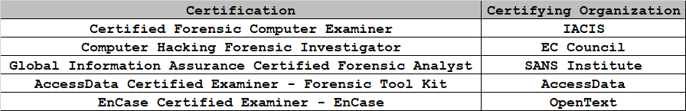
Professional Certifications
There are numerous professional certifications in digital forensics including:

Slide 10
Additional Course Resources
Throughout the course, we will be introduced to numerous organizations, developers, and security professionals that have codified different digital forensics domains
NIST Digital Forensics
Computer Forensic Reference Data Sets
National Software Reference Library
Linux Forensics Tools Repository - LiFTeR
NIST Computer Forensics Tool Catalog
SANS Investigative Forensic Toolkit
Awesome Forensics Github Repo
Enron Email Dataset
Digital Corpora Disk Images
SANS Reading Room
Memory Dumps
STIX

Slide 11
Course Overview
In this course, we will learn how to conduct forensics analysis from the inside to the outside
This course will be divided into the following general forensic concentrations:
Device Analysis
Operating System
File System
Local Network
Perimeter Network
Perimeter
Network
Local
Network
File
System
Operating
System
Device

Slide 12
Digital Forensics Historical Timeline

Slide 13
Digital Forensics Timeline
1995
International Organization on
Computer Evidence Founded
1984
FBI Computer Analysis and Response Team
2003
Forensic Education Program Accreditation Commission
1990
International Association of
Computer Investigative Specialists
1999
Forensic
Toolkit (FTK) Introduced
2008
Sleuth
Kit (Autopsy)
Introduced
Pre-1984
Ad Hoc
Digital Forensics
Ad Hoc Tools
Formal Tools
Open Source Tools
1993
1st FBI Conference on
Computer Evidence
Forensic Association of Computer Technologists
2008
Department of Justice Electronic Crimes Reference Guide
2001
Digital Forensic
Research Conference
1998
Defense Computer
Forensic Laboratory
Expert Witness Introduced (EnCase)
1985
IRS Seized Computer
Evidence Recovery Specialist
2006
Rules for Civil Procedure
“E-Discovery”

Slide 14
Digital Forensics Research Conference

Slide 15
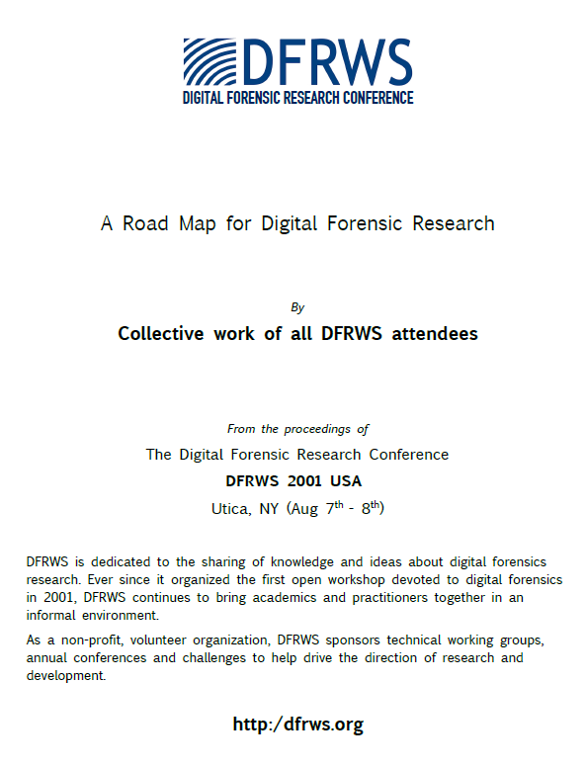
Digital Forensics Research Conference
Just as traditional forensics analysis provides a rigorous process to deal with physical evidence, digital forensics is also developing consistent methods for its digital equivalent
A Road Map for Digital Forensic Research was presented in 2001 at DFRWS
Digital Forensic Science Framework
Digital Evidence Trustworthiness
Detection and Recovery of Hidden Data
Network Forensics

Slide 16
Digital Forensics Usage
Organizations that make use of digital forensics and associated frameworks include:
Law Enforcement (Local, State, Federal)
Military Information Warfare
Business and Industry
Each of these organizations has different objectives when applying digital forensics techniques:
Law Enforcement - Prosecution
Military Information Warfare - Continuity of Operations
Business and Industry – Availability of Services

Slide 17
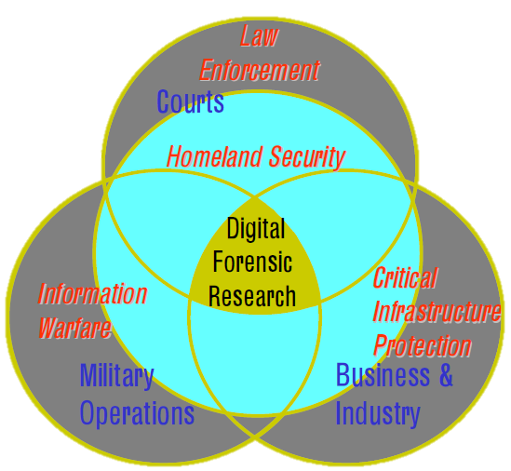
Digital Forensics Research
Digital forensics research can be viewed as interactions between the different organizations discussed earlier:
Law Enforcement
Local, State, Federal
Military Information Warfare
Business and Industry
Lessons learned from law
enforcement, information warfare, and critical infrastructure protection (CIP) work together to provide the foundation of digital forensics research

Slide 18
Digital Forensics Considerations
Technical
Continuous Technology Improvement
Framework and Tool Development
Training
Procedural
No standard analytical procedures
Different terminology
Social
Privacy
Data Sharing
Legal
State
Local
Federal

Slide 19
Digital Forensics Science Framework
For any scientific discipline, there are several important considerations that must be met:
Theory
An agreed set of principles on how the science works
Process
Systematic observation, measurement, and testing process
Elements of Practice
Applicable technologies and tools
Documentation
Professional literature
Usefulness
Proof that the discipline effectively meets a need

Slide 20
Digital Forensics Theory
The Digital Forensics Research Conference defines digital forensics as:
“The use of scientifically derived and proven methods toward the preservation, collection, validation, identification, analysis, interpretation, documentation, and presentation of digital evidence derived from digital sources for the purpose of facilitating or furthering the reconstruction of events found to be criminal or helping to anticipate unauthorized actions shown to be disruptive to planned operations.”

Slide 21
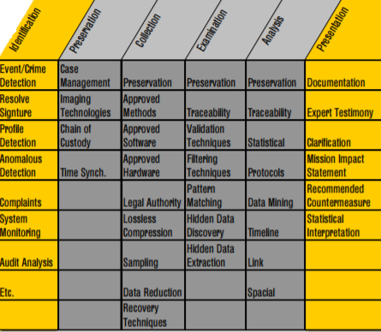
Digital Forensics Investigative Process
6-Step Process
Identify
Preserve
Collect
Examine
Analyze
Present

Slide 22
Digital Forensics
Investigative Process Questions
Categorize each scenario with the correct digital forensics step:
Identify – Preserve – Collect – Examine – Analyze - Present
Imaging a disk
Building timelines with packet captures
Securing a laptop for forensic analysis
Correlating system intrusions with data mining
Providing subject matter expertise for a trial
Finding hidden data on a disk partition

Slide 23
Digital Forensics
Investigative Process Answers
Categorize each scenario with the correct digital forensics step:
Identify – Preserve – Collect – Examine – Analyze - Present
Imaging a disk
PRESERVATION
Building timelines with packet captures
ANALYSIS
Securing a laptop for forensic analysis
PRESERVATION
Correlating system intrusions with data mining
ANALYSIS
Providing subject matter expertise for a trial
PRESENTATION
Finding hidden data on a disk partition
EXAMINIATION

Slide 24
Digital Evidence Trustworthiness
Digital media and data can be manipulated and require a trustworthy process of collecting and storing artifacts
Methods that can be used to ensure data trustworthiness:
Work from an exact copy of the original data
Preserve the data pedigree
Hash
Collection time
Time Offsets
Employ cryptography as a partial solution
Digital signatures – Asymmetric
Encryption – Symmetric and Asymmetric
Understand application metadata
Apply corroborating evidence

Slide 25
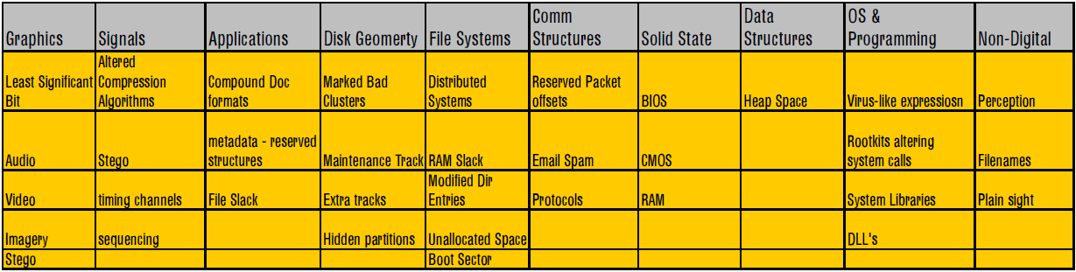
Detection and Recovery of Hidden Data
Digital forensic analysts should understand likely hiding methods and locations used to obscure and conceal data
The Digital Forensics Research Conference identified 10 areas of data hiding that can be used to conceal data
Before attempting media analysis we will identify different data hiding techniques

Slide 26
Detection and Recovery of Hidden Data Definitions
Signals
Steganography
Timing Channels
Applications
File Slack
Disk Geometry
Hidden Partitions
File Systems
RAM Slack
Unallocated Space
Boot Sector
Communication Structures
Reserved Packet Offsets
Protocols
Solid State
BIOS - UEFI
RAM
Data Structures
Stack & Heap Space
Operating System
System Libraries
Dynamic Linked Libraries

Slide 27

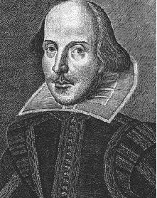
Steganography
Hiding data or media in other media
“Security through obscurity” unless encrypted
There are numerous well-known steganography tools:
OpenStego
Xiao
+

Slide 28
Covert Channels
Modulation of data in a manner that allows data to be indirectly transmitted and prevents detection and analysis
Covert channels can be storage, timing, or hybrid of both
Covert channels include:
CPU Scheduling
I/O Scheduling
Disk Scheduling
I/O Timing

Slide 29
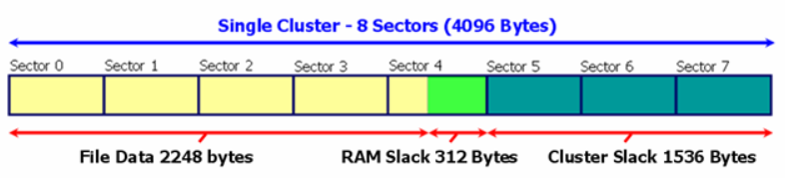
File Slack
Disk image analysis requires understanding of:
Disk Geometry
Sectors – The smallest addressable data element - 512 bytes → 4 KB
Operating Systems – File Systems
Clusters – The smallest addressable data element for a file system – 8 sectors
File Slack is the remaining sectors to the end of a cluster
https://kb.digital-detective.net/display/BLADE1/File+System+Data+Recovery

Slide 30
RAM Slack
RAM slack is the slack between the end of the logical file and the sector
RAM slack is the slack at the byte and sector level
https://kb.digital-detective.net/display/BLADE1/File+System+Data+Recovery

Slide 31
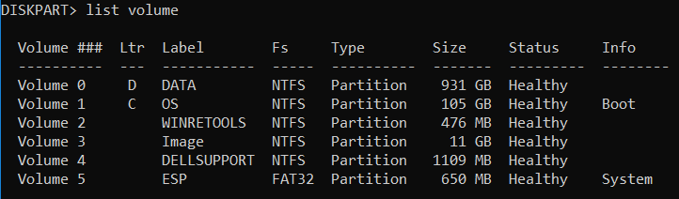
Hidden Partitions
A partition is a unique region on storage media that an operating system can manage
Hidden partitions are generally used to restore default system settings, but can be manipulated

Slide 32
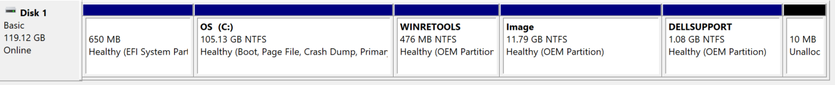
Unallocated Space
Operating systems and their associated file systems allocate storage based on different methods
Allocated space
Contains data
Marked so that it cannot be overwritten
Unallocated space
May or may not contain data
Marked so that it can be overwritten

Slide 33
Protocols
Request for Comments (RFC) specify the technical parameters of communication protocols
Digital forensic analysis will be used to identify potential covert channels and hidden data each OSI layer:
Application
Presentation
Session
Transport
Network
Data Link
Physical

Slide 34
System Boot
There are different capabilities based on the boot method
Basic Input/Output System (BIOS)
Master Boot Record (MBR)
Single boot sector
512 byte disk sectors
4 partition limit
2 TB maximum addressable space
Unified Extensible Firmware Interface (UEFI)
Globally Unique Identifier (GUID) Partition Table (GPT)
512 bytes → 4 KB disk sectors
128 partition limit (OS Dependent)
8ZB → 64ZB maximum addressable space

Slide 35
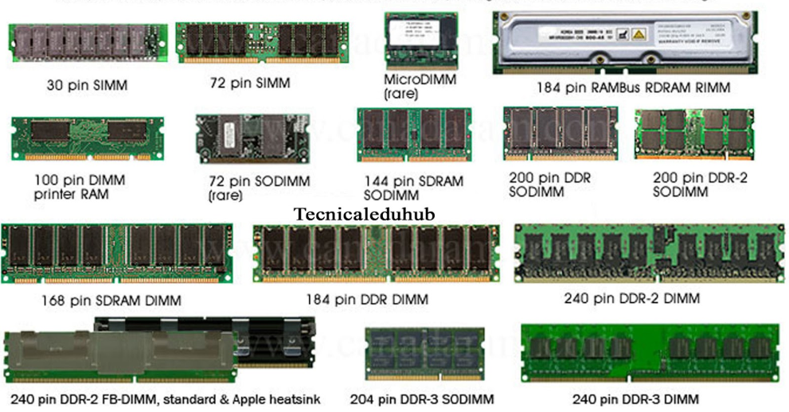
Random Access Memory
There are different technologies used in Random Access Memory (RAM)
Static RAM (SRAM)
Dynamic RAM (DRAM)
Synchronous Dynamic RAM (SDRAM)
Single Data Rate Synchronous Dynamic RAM (SDR SDRAM)
Double Data Rate Synchronous Dynamic RAM
DDR SDRAM, DDR2, DDR3, DDR4

Slide 36
Digital Forensics Legal Considerations

Slide 37
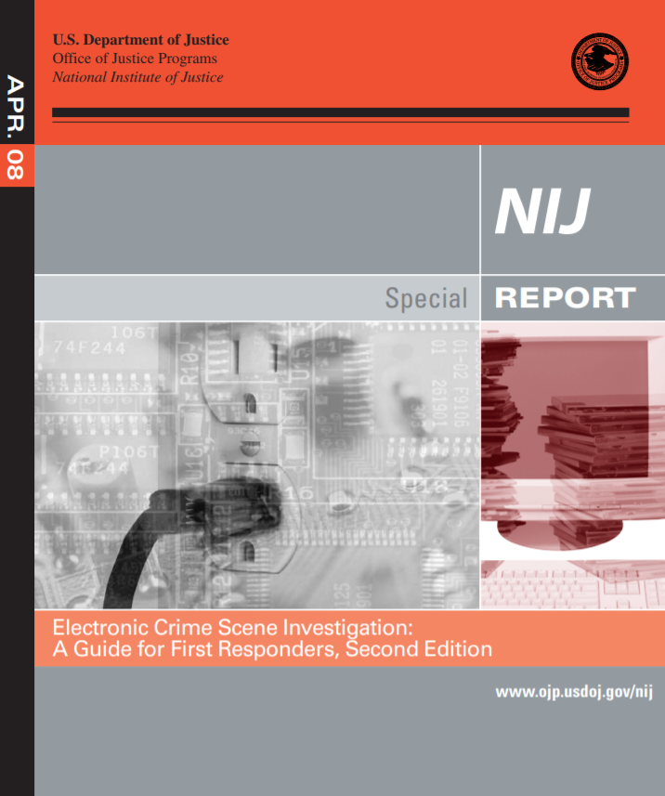
Electronic Crime Scene Investigation
The U.S. Department of Justice published a reference guide for first responders of electronic crimes in 2008
It specifies 14 crime categories and 60 different types of digital evidence
Examples of digital evidence include:
Video cameras
Audio recorders
Sim card reader
Video game consoles
Any electronic device that can internally or eternally save data can result in digital evidence

Slide 38
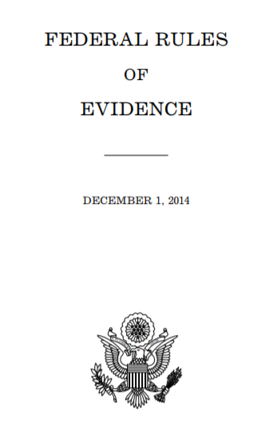
Federal Rules of Evidence
Enacted by Public Law 93–595 and approved January 2, 1975
FRE Articles include:
Article VI – Witnesses
Article VII – Opinions and Expert Testimony
Article VIII – Hearsay
Article IX – Authentication and Identification
Article X – Contents of Writings, Recordings, and Photographs

Slide 39
FRE - Best Evidence
When considering different digital data sources, it is important to understand the distinction between different evidence types as defined by the Federal Rules of Evidence:
Best Evidence – FRE 1001
“For electronically stored information, “original” means any printout — or other output readable by sight — if it accurately reflects the information.”
Actual memory vs. memory dump

Slide 40
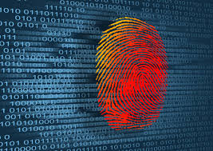
Locard’s Exchange Principle
Locard’s Exchange Principle “holds that the perpetrator of a crime will bring something into the crime scene and leave with something from it, and that both can be used as forensic evidence.”¹
The concept that “every contact leaves a trace” holds both in physical and electronic forensics

Slide 41
Computer Generated vs.
Computer Stored Records
Computer Generated
Data generated by a computing system or program
Computer Stored
Records or documents generated by a user
Depending on the type of data generated determines whether it is considered hearsay in a court of law:
Computer generated data is considered direct evidence - FRE 803(6)
Computer stored data is considered hearsay unless corroborated

Slide 42
Computer Generated vs.
Computer Stored Records Questions
Identify which digital artifacts are computer generated and which are computer stored:
Email
Chat Session
Security Logs
Packet Capture
Cron Job
Intrusion Detection Alerts

Slide 43
Computer Generated vs.
Computer Stored Records Answers
Identify which digital artifacts are computer generated and which are computer stored:
Email – Computer Stored
Chat Session – Computer Stored
Security Logs – Computer Generated
Packet Capture – Computer Generated
Cron Job – Computer Generated
Intrusion Detection Alerts – Computer Generated

Slide 44
Evidence Collection and Archiving

Slide 45
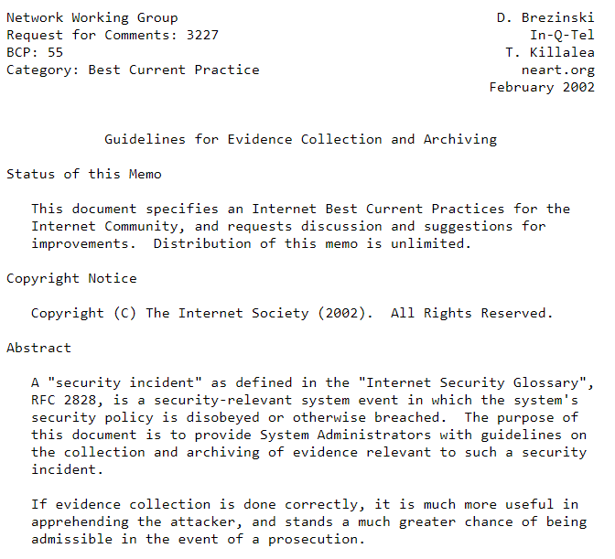
Guidelines for Evidence Collection and Archiving
Request for Comment (RFC) 3227 specifies best practices for digital evidence collection and storage
Guiding Principles during Evidence Collection
The Collection Procedure
The Archiving Procedure
Tools
References

Slide 46
RFC 3227 - Order of Volatility
When conducting a forensics analysis, it is necessary to understand how data is retained in a system
Depending on whether collection is conducted on a running or non-running system will determine how much data is available for analysis
The following list
CPU Cache and Registers
Routing Tables / ARP Cache / Process Tables / Kernel Statistic / RAM
Temporary File Systems / Swap Space
Remote Logging / System Monitoring Data
Physical Configuration / Network Topology
Archival Media

Slide 47
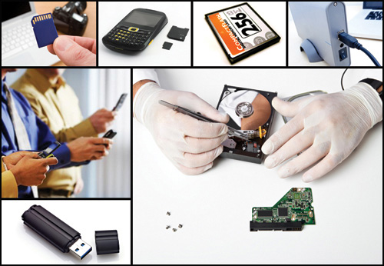
Digital Evidence Collection Legal Considerations
RFC 3227 specifies 5 legal considerations when presenting digital evidence:
Admissible: It must conform to certain legal rules before it can be put before a court
Authentic: It must be possible to positively tie evidentiary material to the incident
Complete: It must tell the whole story and not just a particular perspective
Reliable: There must be nothing about how the evidence was collected and subsequently handled that casts doubt about its authenticity and veracity
Believable: It must be readily believable and understandable by a court

Slide 48
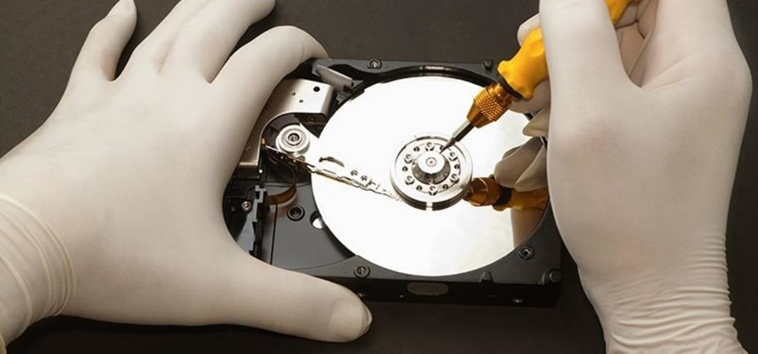
Digital Evidence Collection
Capture System Image
Take forensic images of all systems and devices
Live vs. dead collection
Bit-by-bit copy
Document Network Traffic and Logs
Analyze network connections and system logs
Record MAC times (Modified, Accessed, Created Times)
Record Time Offset
Note local vs. standard time offsets
Calculate Hashes
Images – Files - Logs
Hash types
MD5, SHA256, SHA512

Slide 49
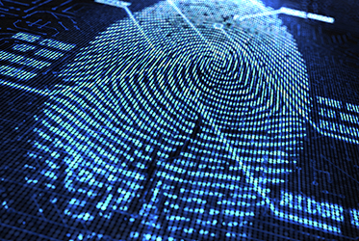
Additional Forensics Evidence Collection Activities
Capture Screenshots
If relevant, use screenshots to demonstrate activities that can be used to explain the incident
Interview Witnesses
Identify and communicate with those directly impacted by the incident and determine how the indecent occurred from their perspective
Track Man Hours and Expenses
Due to the significant time needed to conduct investigations of this type, ensure expenses are properly captured

Slide 50
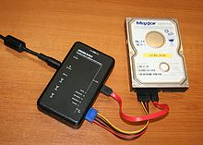
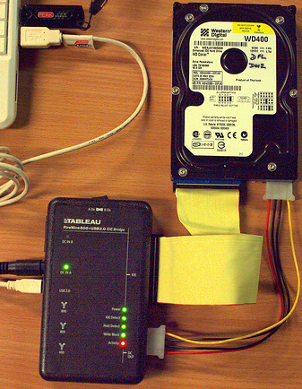
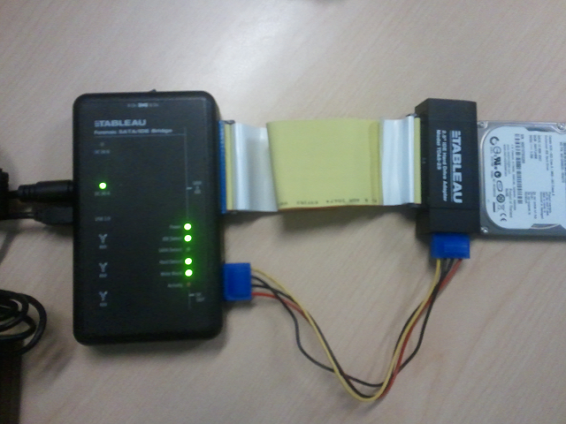
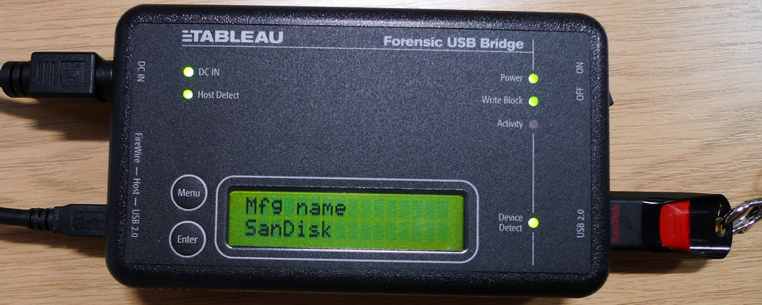
Data Collection
Write blocks are essential to the collection process and include both hardware and software variants
There are a number of NIST recommended write blocker recommendations
https://www.cftt.nist.gov/hardware_write_block.htm
Software write blockers are less reliable

Slide 51
Digital Forensics and Incident Response

Slide 52



Threat Actors
During the analysis process, it is important to define threat actors and the organizational response the successful malicious activities
Advanced Persistent Threat (APT)
Technical
Profit
Hacktivists
Malicious Insider

Slide 53

Incident Response
Digital forensics will be applied based on the identified threat and organizational policy
Incidents are any activities launched against organizational resources that attempt to gain unauthorized access, violate security policy, or compromise system resources
An effectively incident response will include:
Incident definitions
How incidents are forensically analyzed
How incidents are reported

Slide 54
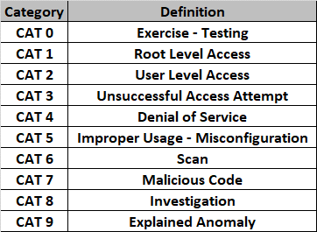
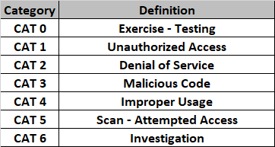
Incident Definitions
Numerous organizations define security incidents and the methods that should be employed to properly respond:
Department of Defense (DoD)
National Institute for Standards and Technology (NIST)
NIST Incident Categories
DoD Incident Categories*

Slide 55
Incident Category Questions
What incident category does each of the following scenarios fall into?
A forensic disk analysis results in positive identification of a rootkit
Network traffic artifacts shows multiple port scans
Security log analysis shows successful escalation to and administrative level system access
A forensic analysis of a Windows registry shows multiple violations of software installation policy

Slide 56
Incident Category Answers
What incident category does each of the following scenarios fall into?
A forensic disk analysis results in positive identification of a rootkit – 7
Network traffic artifacts shows multiple port scans - 6
Security log analysis shows successful escalation to and administrative level system access - 1
A forensic analysis of a Windows registry shows multiple violations of software installation policy - 5

Slide 57
Incident Response Policy
At a minimum, an incident response policy must include the following:
Incident Identification
Tools and procedures to detect threats
Incident Investigation
Trained personnel
Incident Damage Repair
Remediate incident damage
Documenting Organizational Response
Document all technical and administrative procedures
Updating Incident Response Procedures
Integrate lessons learned into future response

Slide 58

Incident Response Personnel
First Responders
Who responds when an incident occurs
Physical Security
Network Security
Incident Response Teams
How are teams established
By Function
Dictated by Incident
What training is required
Incident Severity Identification
Notification Process
Mitigation Process
Incident Isolation

Slide 59
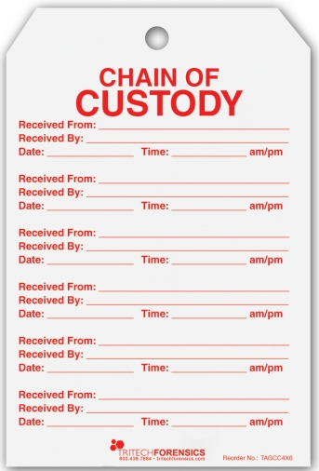
Chain of Custody
To ensure proper control of all collected evidence it is necessary to develop a effective handling process
The critical steps in a chain of custody include:
Document items collected
Identify collecting agent
Segregate items in containers
Calculate hash values of each item
Securely transport evidence
Conduct proper hand-off of evidence
Secure items when stored

Slide 60
Forensics Testing Environment Configuration

Slide 61
Assignment - Due 16 January
Install Type II Hypervisor
Windows
VMWare Workstation Player
Mac / Windows
Oracle Virtual Box
SANS Investigative Toolkit (SIFT)
SANS SIFT
Submit 1 page summary of working environment

Slide 62
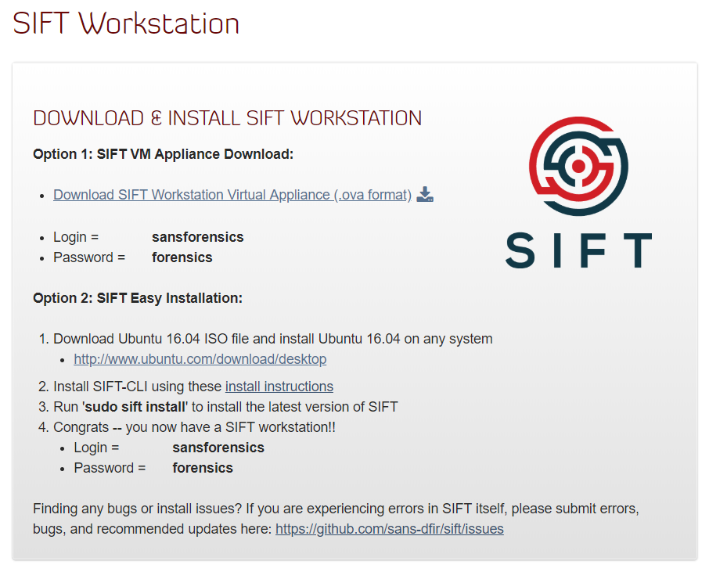
SIFT Installation
https://digital-forensics.sans.org/community/downloads

